Slide 1
INSTITUTIONAL RATIONALISATION: WATER RESOURCES AND SERVICES MANAGEMENT REFORM – A PROPOSAL Masiphula Mbongwa Special Ministerial Advisor
PRESENTATION TITLE
Presented by:
Name Surname
Directorate
Date
INTERACTIVE session of the minister with water services authority
Birchwood
Boksburg
25 January 2019

Slide 2
Outline
Water and sanitation status quo
Current institutional arrangements
New institutional arrangements
Proposed institutional reforms

Slide 3
Existing water and sanitation institutions
MINISTER
WATER RESEARCH COMMISSION
Breede
Gouritz
Inkomati Usuthu
Trans Caledon Tunnel Authority
Komati Basin Water Authority
Limpopo
Pongola
UMzimkhulu
Amatola
Bloem
Berg-Olifants
Olifants
Lepelle
Magalies
Orange-Sengqu Commission
Limpopo Commission
Orange
Tsitsikama Mzimvubu
Mhlathuze
Overberg
Water Services Authorities
Rand
Sedibeng
Vaal
Water Users Associations
Umgeni
Source: Adapted from National Water and Sanitation Master Plan presentation to AgBiz Congress, Department of Water and Sanitation, 2018, Slide 6.
25 statutory entities are currently supervised by the Minister in terms of the National Water Act and the Water Services Act;
There is no national state owned entity that supervises the 9 CMAs, 9 Water Boards, 256 Water Service Authorities, 4 International Water Management Entities, and 278 untransformed irrigation boards on behalf of the Minister;
The Minister must therefore supervise a total of 556 statutory entities;

Slide 4
Water and sanitation status quo
Only two out of nine CMAs are established and fully operational, the function of the rest is performed by the Department as Proto CMAs;
This means that seven catchment management areas continue to operate under the apartheid 1956 Water Act with 278 untransformed irrigation boards with vast properties and water works built with state investments and subsidies owned by private interests that control water supply to cities, towns, industries and rural communities;
all municipalities, including eight metros, have Constitutional powers to provide water and sanitation to communities and industries, but there is no standard means to get them tested to operate as Water Services Authorities;
Water Boards are not established on the basis of a clear, coherent and consistent framework;
There is incoherence and failure in throughout the water and sanitation system - from resource development to the waste water treatment value chain side.

Slide 5
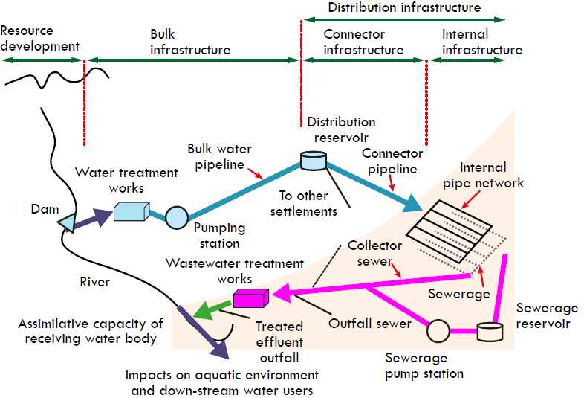
WATER SERVICES BUSINESS LIFECYCLE
National
Municipalities
Source: Department of Water Affairs, Strategic Overview of the Water Sector in SA, 2013, Slide 18
There is complete, systemic institutional and operational failure in the water and sanitation sector value chain – from the resource development side right to reticulation and waste water treatment side.

Slide 6
New water and sanitation institutional configuration
MINISTER
Water & Sanitation Authority
Water & Sanitation Regulator
Water Research Commission
International Water Management Institutions
Council of Water Services Authorities
Breede
Gouritz
Inkomati Usuthu
Amatola
Overberg
Trans Caledon Tunnel Authority
Komati Basin Water Authority
Limpopo
Pongola
Mzimkhulu
Lepelle
Magalies
Orange- Sengqu Commission
Limpopo Commission
Berg-Olifants
Olifants
Bloem
Mhlathuze
Orange
Tsitsikama Mzimvubu
Rand
Sedibeng
Vaal
Umgeni
Water Services Providers
Water Users Associations
Source: Adapted from National Water and Sanitation Master Plan presentation to AgBiz Congress, Department of Water and Sanitation, 2018, Slide 6.
WATER USERS
Notes:
The Minister as a Shareholder has distinct responsibilities including
Appoint all Board members
Conclusion of binding shareholder compacts.
Approval of Strategic Plans and Corporate Plans/Annual Performance Plans.
Quarterly reporting
Instruct the entities by directives
Issuing of a strategic intent statement.
Approval of significant & material transactions.
Recommendations of borrowing limits to National Treasury.
Access information to monitor and evaluate performance.
Enforce accountability and take remedial action.

Slide 7
Existing water and sanitation institutions must change
WATER AND SANITATION MINISTRY
NATIONAL WATER AND SANITATION AUTHORITY
Water Trading Entity
Construction Company
Manufacture Company
Regional Water Boards
CMAs
CMAs
CMAs
CMAs
CMAs
WSAs
WSAs
WUAs
WUAs
WUAs
WUAs
WUAs
WATER USERS
WATER USERS
WATER USERS
WATER USERS
WATER USERS
Source:, Department of Water and Sanitation, 2018.

Slide 8
Existing water and sanitation institutions
WATER AND SANITATION MINISTRY
Water and Sanitation Inspectorate
Guidelines, Norms and Standards
Water Tribunal
NATIONAL WATER AND SANITATION REGULATOR
Water User Authorisation
Pricing, Tariffs and Charges Authorisation
Water Institution Authorisation
CMAs
CMAs
CMAs
CMAs
CMAs
CMAs
CMAs
WUAs
WUAs
WUAs
WUAs
WUAs
WATER USERS
WATER USERS
WATER USERS
WATER USERS
WATER USERS
Source:, Department of Water and Sanitation, 2018.

Slide 9
Summary of water and sanitation reform
Establish a Council of Water Services Authorities (CWSA), in terms of Chapters III and VIII of the Water Services Act, as a political structure to oversee the delivery of water and sanitation to the people and sectors of the economy.
Proven capacity to perform water and sanitation functions in Chapters III and VIII of the Water Services Act should get municipalities the license to operate as Water Services Authorities from the envisaged Water and Services Regulator; and proven incapacity should result in the revocation of a license and takeover of the function and its delegating to the Water Board within the Catchment Management Area. .
Introducing the operating license for municipalities should result in adjustments to the Regional Bulk Infrastructure Grant (RBIG), Water Services Infrastructure Grant (WSIG) by a technical task team of officials from DWS, CoGTA, National Treasury, provinces and SALGA;
Two national water boards should be established in terms of section 28 of the Water Services Act with assigned powers to operate one as a National Water and Sanitation Authority, and the other one as a Water and Sanitation Authority;
Establish Water Boards to operate as regional utilities at the level of the official nine water management areas;
The Trans Caledon Transboundary Authority (TCTA) should continue to operate in its assigned main international area of activity, with functions outside its main activity assigned to Water Boards, CMAs or the National Water and Sanitation Authority when established – unless there is a case for institutional syndication among water and sanitation entities;
Establish a Council of International Water Management (CIWM) as a political structure to oversee activities of water management between South Africa and neighbouring African countries and further afield in terms of Chapter 10 of the National Water Act.

Slide 10
Summary of water and sanitation reform
Establish the DWS principally as a policy, legislation, programme support, monitoring and evaluation organisation, with functions that need dedicated and on-going technical, scientific, specialist, financial, operational and management attention being assigned to Water Boards, Water Research Council, the envisaged Water and Sanitation Authority, the Water and Sanitation Regulator, and the CMAs.
Finalise the establishment of CMAs in the remaining 7 catchment management areas;
Direct old water rights user organisations to convert to Water Users Associations within the next 6 months;
Minister to direct current Water to submit studies with proposals of how they shall convert to become Water Regional Utilities within 6 months;
Direct Workstream on the Water and Sanitation Authority and the Water and Sanitation Regulator to submit reports on the establishment of the Water and Sanitation Authority and Regulator;
Direct the DDG Corporate Services to submit the preliminary report on the Institutional Reorganisation of the Department of Water and Sanitation.

Slide 11
Thank you

